Slide 1
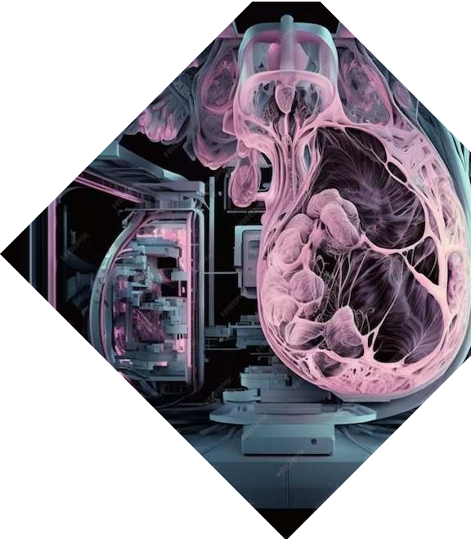
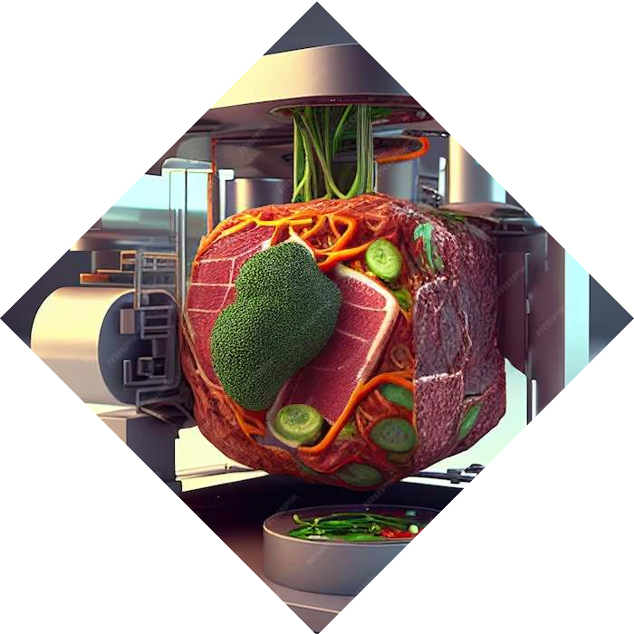
Unveiling the Power of Hough Transform: A Comprehensive Exploration of its Applications and Techniques
Sathwik Vintha - 2110110469
Harshvith Vydana - 2110110763

Slide 2
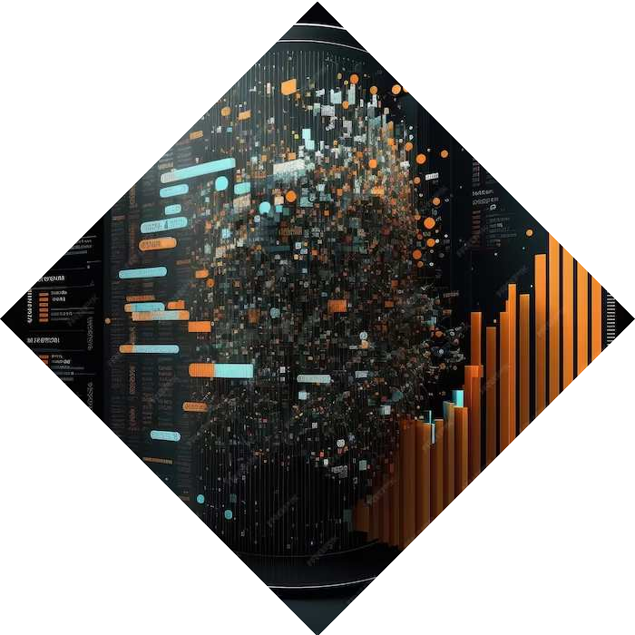
Introduction
The Hough transform was first proposed by Paul Hough in 1962 as a method for detecting lines in images. It was later extended to detect other shapes like circles and ellipses. This presentation will delve into the power of the Hough Transform and its impact on various ﬁelds.

Slide 3
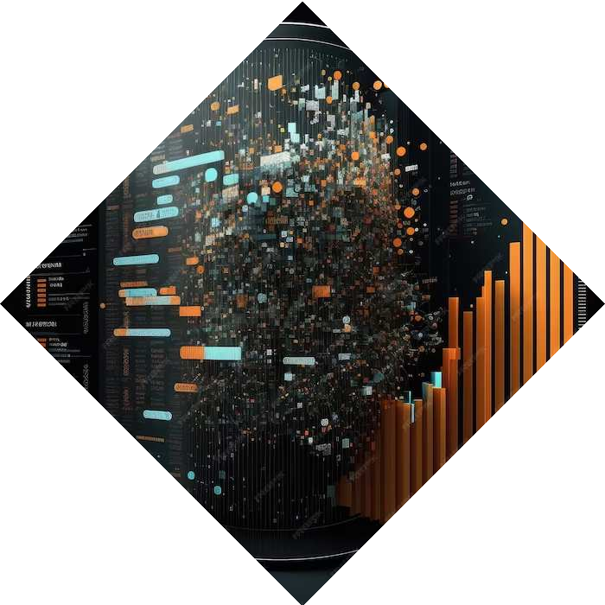
Abstract
Hough Transform (HT) simplifies line detection by converting it into a task of finding peak points in a parameter space.
Generalized Hough Transform (GHT) extends this to detect arbitrary shapes by representing them as single points in the parameter space.
GHT efficiently detects lines even in noisy or incomplete images, enhancing robustness
Steps involved in GHT include edge detection, accumulator array initialization, voting, peak detection, and thresholding.

Slide 4
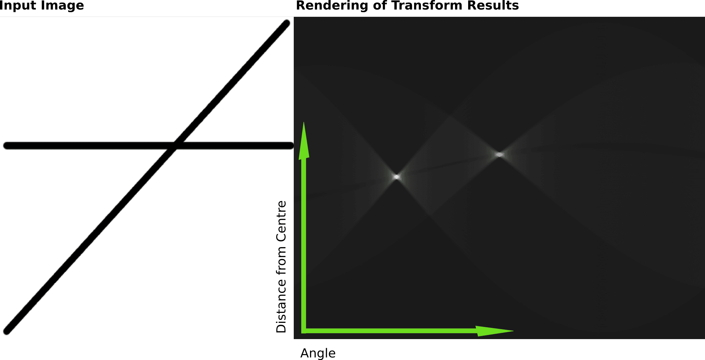
Understanding Hough Transform
The Hough Transform is a technique used in image processing and computer vision for detecting shapes, particularly lines and circles, in an image.It was initially developed to identify patterns in binary
images, focusing on the problem of line detection.The Hough Transform represents lines in a polar coordinate system (rho, theta).Each point (x, y) in Cartesian space corresponds to a sinusoidal curve in
the Hough space.

Slide 5
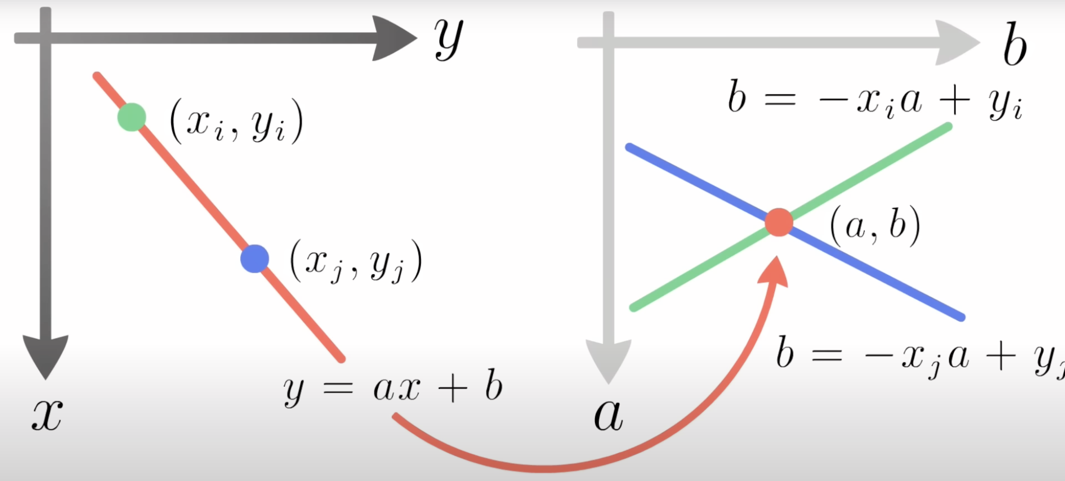
Mathematical Representation of Hough Transform

Slide 6
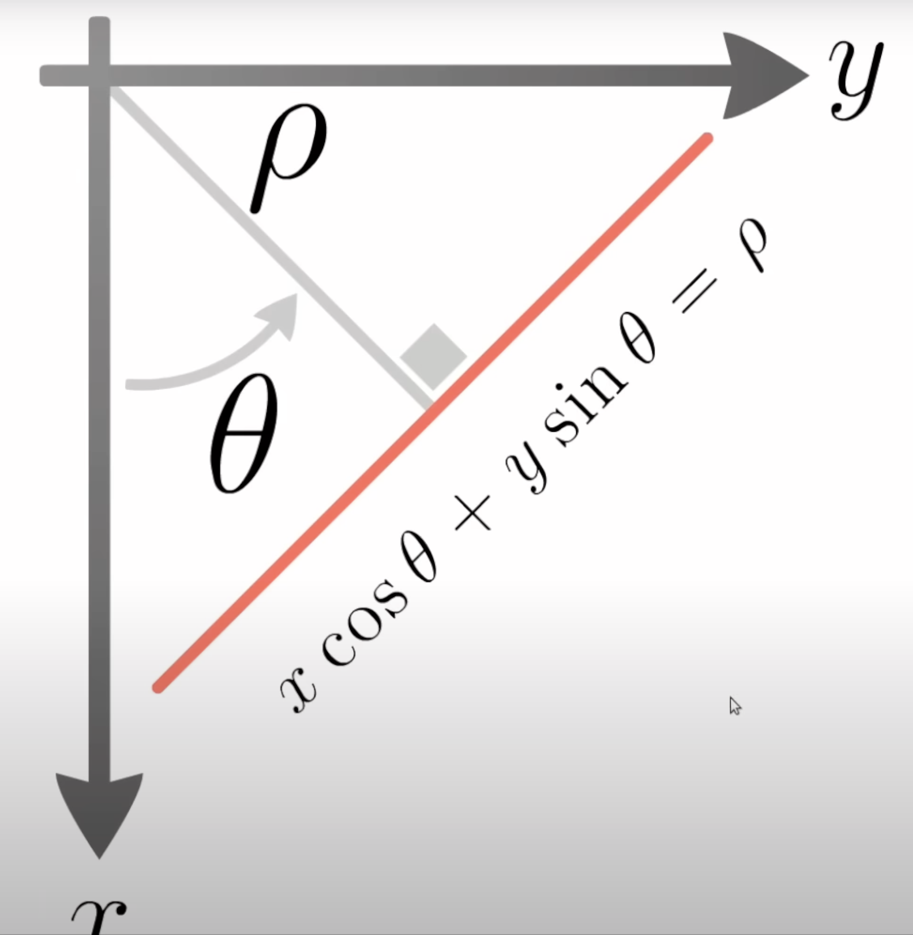
ρ (rho) and θ (theta)
The rho parameter corresponds to the distance from the origin to the closest point on the line. The theta parameter represents the angle between the x-axis and the normal to the line.

Slide 7
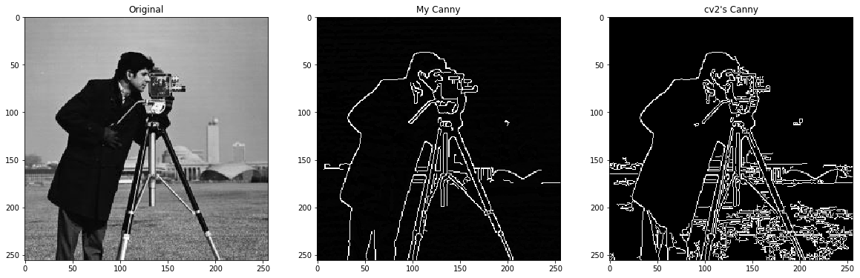
Edge Detection
Prior to the Hough Transform, edge detection algorithms (e.g., Canny edge detector) are often applied to identify potential lines. Here, we find the aligned points in the image that creates the lines.
Input Image
Edge Image
Lines Detected

Slide 8
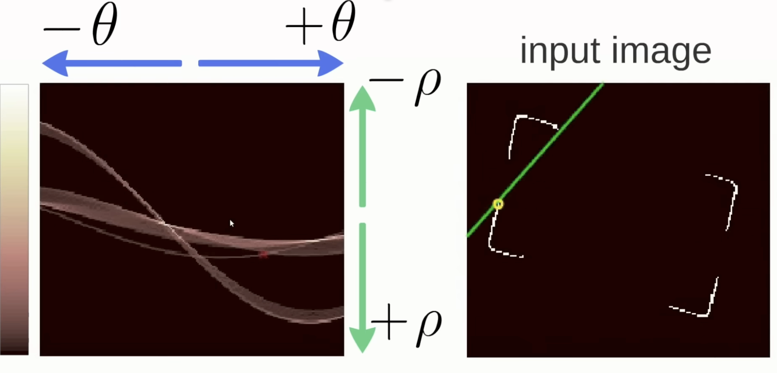
Working of Hough Transform Algorithm

Slide 9
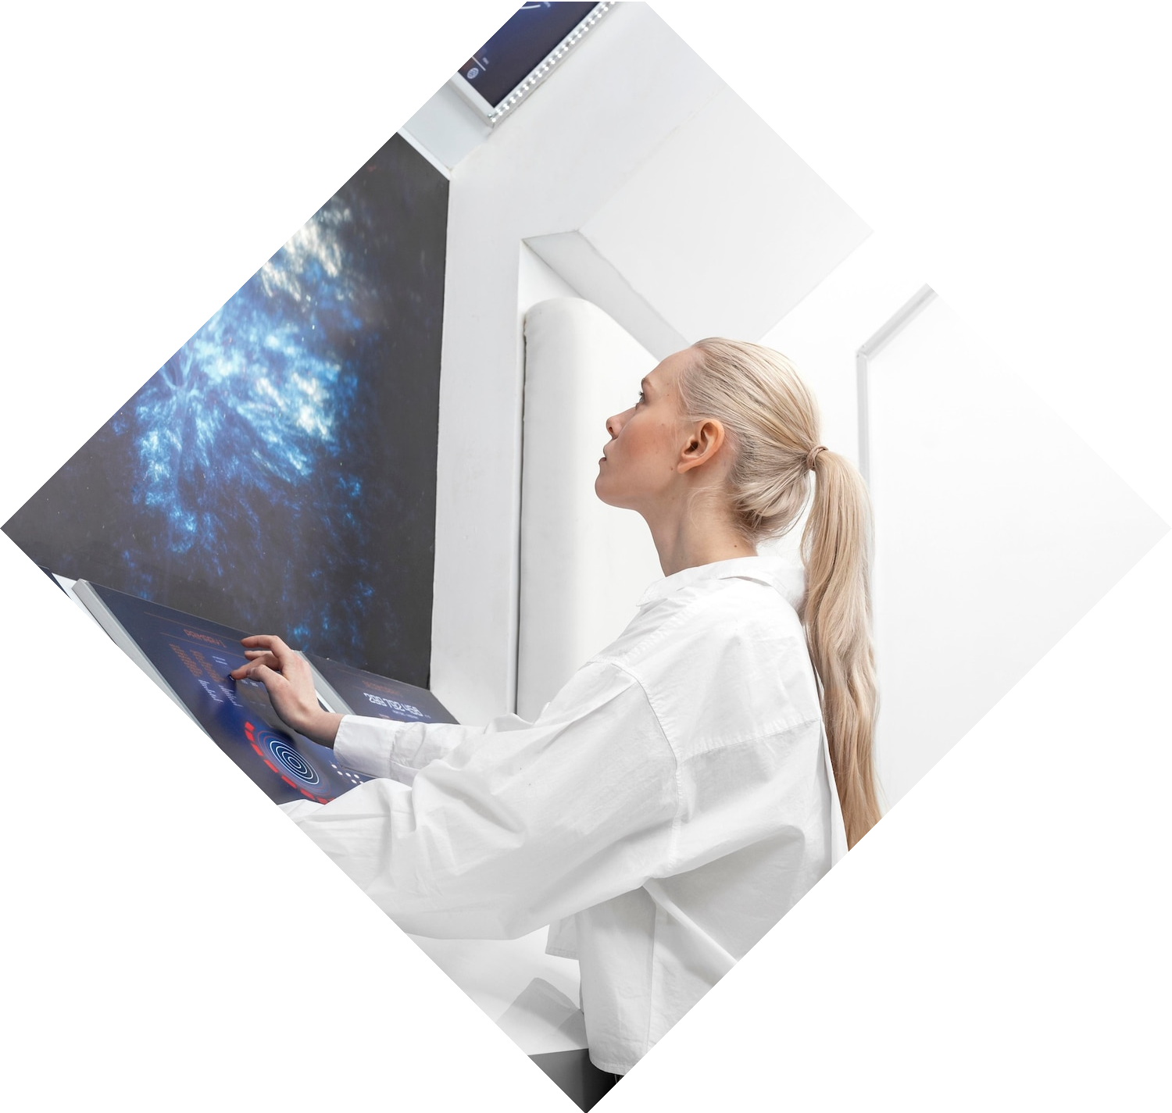
Challenges and Limitations
Sensitivity to parameter tuning can be a challenge.Computational complexity can increase with larger images and complex scenes.
Handling noise and partial occlusion in real-world images.Addressing computational demands for large-scale image processing.

Slide 10


Future Directions and Innovations
Deep Learning Integration: Integrating deep learning techniques to enhance accuracy and efficiency.
2. Real-time Optimization: Optimizing algorithms for real-time performance in critical applications.
3. Multi-scale Analysis: Enhancing capability to detect objects at various scales and handle distortions.
4. Hardware Acceleration: Developing specialized hardware accelerators for faster computations and lower power consumption.

Slide 11
Code Implementation
Link :- https://colab.research.google.com/drive/1N6MXmypQbD1MU0XK0ktbz2bhOMWLel01?usp=sharing

Slide 12
Conclusion
In conclusion, the Hough Transform stands as a cornerstone in pattern recognition, image analysis, and computer vision. Its wide-ranging applications and potential for further advancements make it an indispensable tool in modern technology.

